Slide 1
EUMOFA Talk
Digitalisation of the fisheries sector and full traceability of fishery and aquaculture products: achievements and remaining challenges
25 January 2024

Slide 2
Jennifer Leroux –
Supply chain manager, Association of buyers of fisheries products in Brittany.

Slide 3
Difficulties encountered in applying the Control Regulation,
The industry's needs and adaptations to achieve compliance,
Tracabapp Software developed by professionals for professionals,
Challenges of the new rules,
Notes:
I will present you how fishwholesaler deals with control regulation.
1,2,3,4,
But 1st of all, i just present myself and the compagny i work for

Slide 4
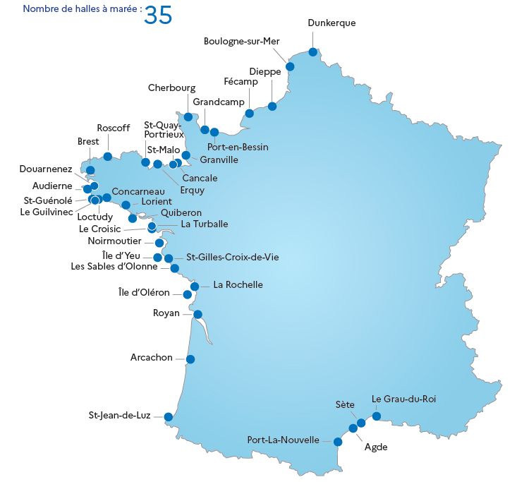
About us:
Abapp is a buyers' association which, since 1994, has handled the financial flows between Brittany’s
13 fish auctions and its members.
Notes:
Im jl I used to be quality manager for a small company of fish wholesaler for more than 10 years and I am supply chain manager in Abapp since 6 years now.
300 Members are registered.
Purchases and transactions made by our members are confidential.
Only the fish auction, the buyer and us are aware of the amount transacted.

Slide 5
Difficulties encountered in applying the Control Regulation:
Fish Wholesaler are mainly small compagnies from 2 people to less than 50 employees.
Bigger companies are structured, smaller ones are not.
For example, they don’t have quality manager in their team,
Information relating to health traceability is formalised in their own HACCP procedures and processed in their company software.
Until now, Traceability data is transmitted by fish auctions in PDF.
→ The data is therefore entered batch by batch by an employee every morning,
only a few variables to be processed on a daily basis, such as the batch number and the auction of purchase.
Notes:
IN britanny: Fish Wholesaler are mainly small compagnies from 2 people to less than 50 employees.
Their job is to buy many fish batches, sort them, cut them and arrange them according to their customers' specifications.
…
When a fishwhosaler buys an average of 150 batches a day… it’s a very time-consuming task.

Slide 6
Difficulties encountered in applying the Control Regulation:
CONTROL
Regulation
INCO Regulation
OCM
Regulation
2009
2011
2013
Major changes in daily work
However, the seafood processing plants remains unchanged.
Notes:
In nearly 2010 sees the arrival of a regulatory package: the INCO regulation (R1169/2011), the control and OCM regulation (R1379/2013)
which will mean major changes in product traceability.
However, the organisation of seafood processing plants remains unchanged.

Slide 7
Difficulties encountered in applying the Control Regulation:
20 lines of information to be entered / purchase batch.
Daily:
100-250 batches of row seafood product bought every day
From 13 different seafood auctions
Notes:
From now, it's no longer just a few traceability criteria that need to be entered on a daily basis, but nearly twenty criteria per purchase batch.
When a fishwholesaler buys an average of 150 batches every morning from several auctions.
= Manual entry becomes impossible.

Slide 8
The industry's needs and adaptations to achieve compliance,
Faced with this situation,
-> The method of transmitting information for 1st purchases needs to evolve.
For less structured companies, it's time to evolve in order to
- develop their business software or change it, if it’s too obsolete,
- renegotiate with label manufacturers (who have become too small) to include all the necessary information,
- Recruiting to process upstream traceability information...
BUT…
Time to standardised traceability data
from all Britanny seafood auctions
Notes:
But… This last point quickly became the most difficult, given the recruitment difficulties experienced at the time.
It’s definitely time to…

Slide 9
Tracabapp Software developed by professionals for professionals,
And just as, in 1994, we had imagined Brittany as a single "financial" fish auction,
We imagined Brittany as a single "traceability" fish auction.
In order to remove all the obstacles encountered and turn a regulatory constraint into a genuine development for our industry.
In 2010, we began designing the architecture of the TRACABAPP software.

Slide 10
Tracabapp Software developed by professionals for professionals,
During the sale, the software interrogates the 13 fish auctions,
Batch traceability data are returned to Tracabapp.
Homogenised by the software,
Recorded by buyers in a secure database.
Real-time access for members on a dedicated, secure area.

Slide 11
Tracabapp Software developed by professionals for professionals
Notes:
And this is how it looks
One line is one batch

Slide 12
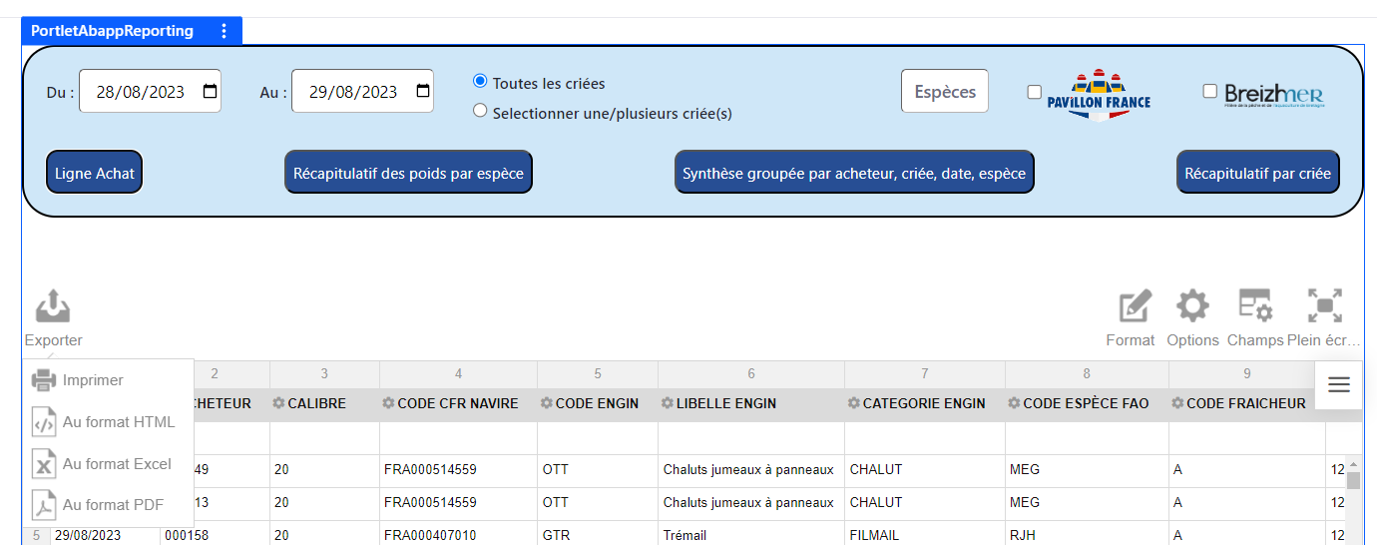
Tracabapp Software developed by professionals for professionals
Notes:
And In one click, the traceability data is transmitted to the company's business software.
Putting an end to processing time and the risk of human error.

Slide 13
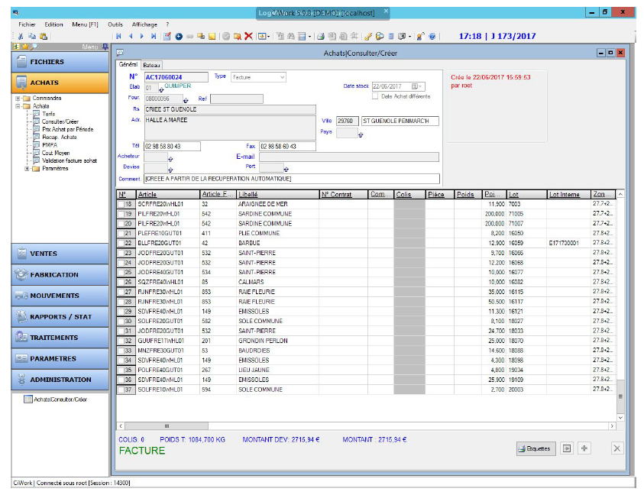
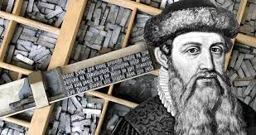
Exemple of a Purchase order in a company’s business software.
Tracabapp Software developed by professionals for professionals,
Notes:
This is an exemple of a purchase order in a company's business software.
Saying that Tracabapp has created a revolution in our Brittany industry as important as Gutenberg and the invention of printing would be a little pretentious. Because even if this software has made work flow more smoothly for the companies that use it,
Tracabapp equips all of Brittany's fish auctions, but only 13 of France's 35 fish auctions.
There is still work to be done...

Slide 14
The challenges of the new rules
Having data:
At the right time and in the right format.
Today, information is transmitted by:
- Tracabapp,
- Other digital format,
- PDF.
Real-time transmission:
All fish auctions must be equipped with a system for dematerialising traceability data.
Notes:
Dans l’Etat actuelle de numérisation de la filière.
without that, it will never work

Slide 15
Thank you for your attention

